Slide 1
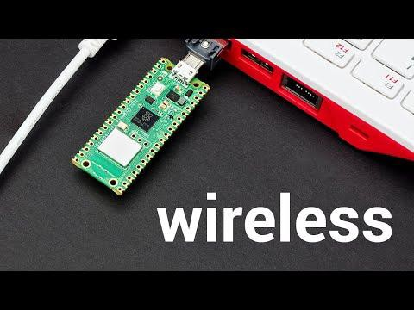
Overview of Raspberry Pi Pico W

Slide 2
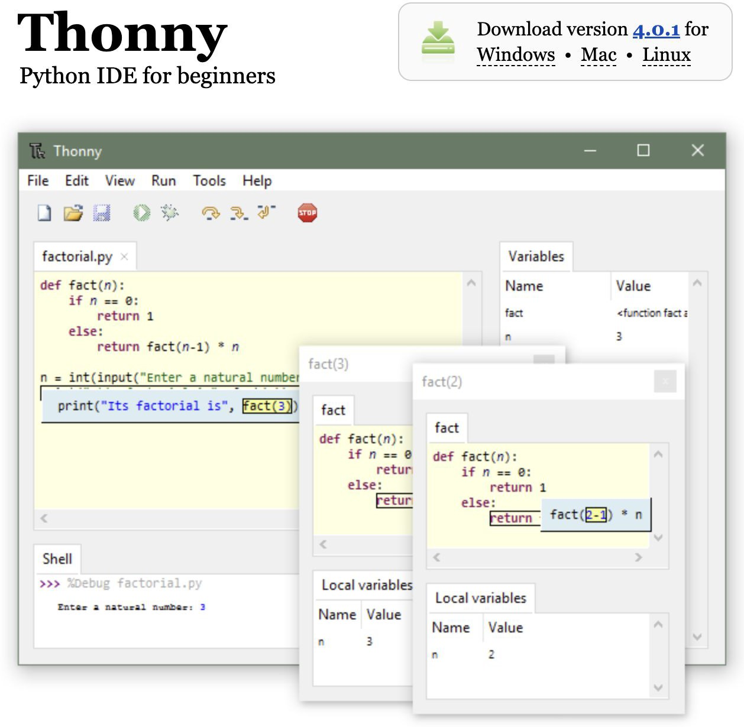
Download Thonny IDE
Thonny IDE was part of the Raspberry Pi Operating System (formerly Raspbian) for ages.
It is a Python IDE that is beginner friendly.
Easy to get started and simple to debug codes.
Download the Thonny IDE from https://thonny.org/

Slide 3
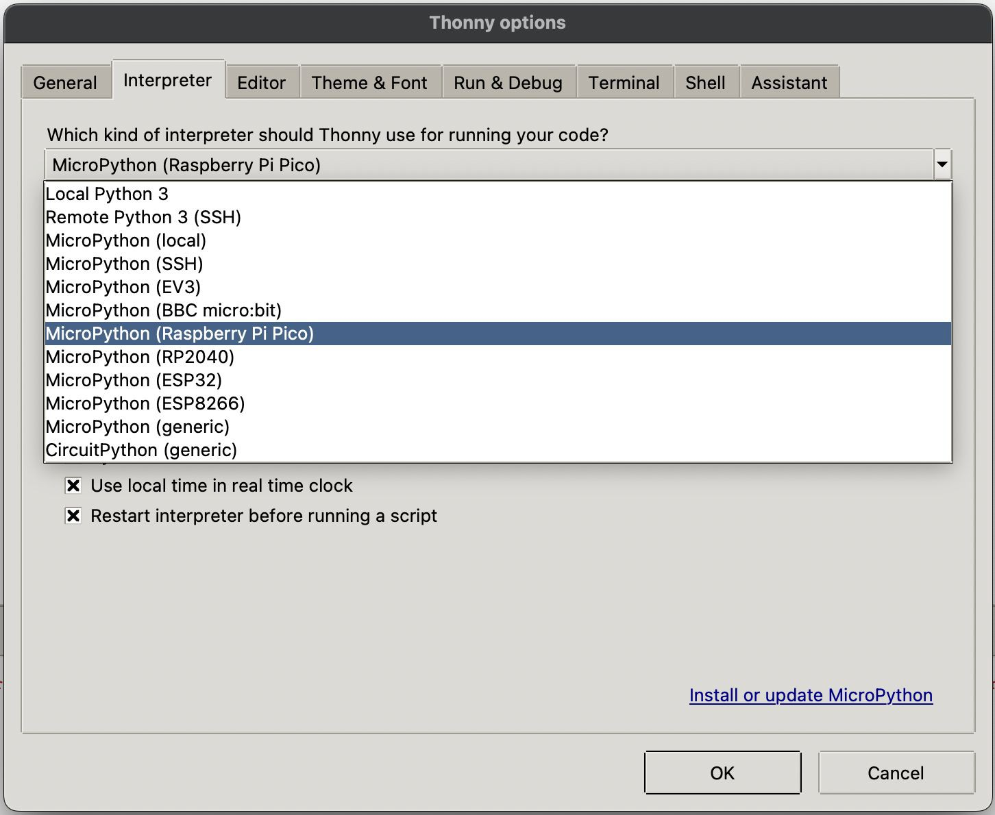
Conﬁgure Thonny IDE
Open up Thonny IDE software.
Go to ‘Tools’ -> ‘Options’, and under ‘Interpreter’ tab, select ‘MicroPython (Raspberry Pi Pico)’.
Click ‘OK’ to close.

Slide 4
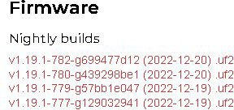
Download MicroPython UF2 ﬁle
MicroPython is a lean and efficient implementation of the Python 3 programming that includes a small subset of the Python standard library.
MicroPython aims to be as compatible with normal Python to allow code transfer from the desktop to a microcontroller with ease.
Go to https://micropython.org/download/rp2-pico-w/
Recommend to download the latest nightly build ﬁrmware.

Slide 5
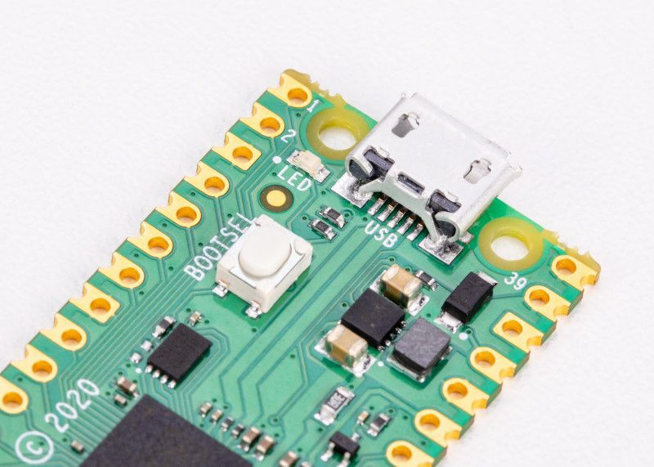
Boot and Install MicroPython
To get started on the Raspberry Pi Pico W, you need to connect a microUSB cable to the Pico W board.
Before you plug the other end into the computer, press and hold the BOOTSEL button.
Continue to hold the button for a few more seconds after connecting to the computer before releasing.
A new drive (RPI-RP2) will appear on your computer.
Drag and drop the UF2 ﬁle onto the RPI-RP2 drive.
The Pico W will auto reboot and run MicroPython.

Slide 6
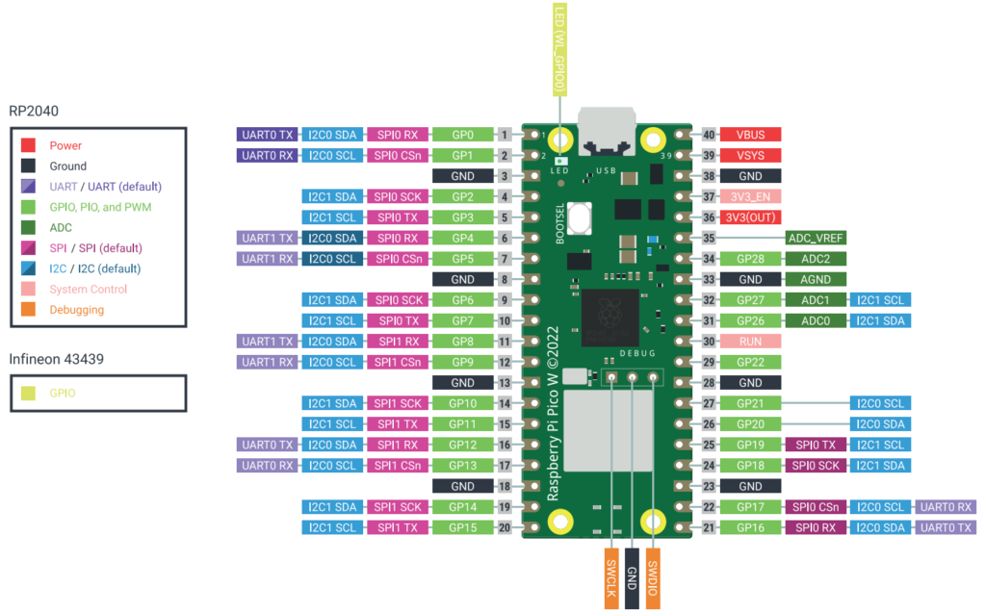

Slide 7

LED PINOUT
Longer pin is Anode

Slide 8
from machine import Pin
import utime
#led = Pin('LED', Pin.OUT) #onboard LED
led = Pin(2, Pin.OUT)
led.low
while True:
led.toggle()
print("Toggle")
utime.sleep(1)

